Slide 1


GLOBAL INSTITUTE OF TECHNOLOGY
Department of
Computer Science & Engineering
Subject with code: 3CS4-23: Software Engineering Lab
Experiment-1: Introduction to
Software Engineering and Project Management
Presented by:
Mr. Vivek Sharma
Assistant Professor
CSE, GIT, Jaipur

Slide 2
Contents
Scheme and Syllabus of SE Lab
Introduction to Software Engineering Lab
Lab Objectives
Introduction to Software Engineering
Software Activities in A Process Model
Various Process Models
Project Planning and Management
Risk Management
Tools Used in the Lab

Slide 3
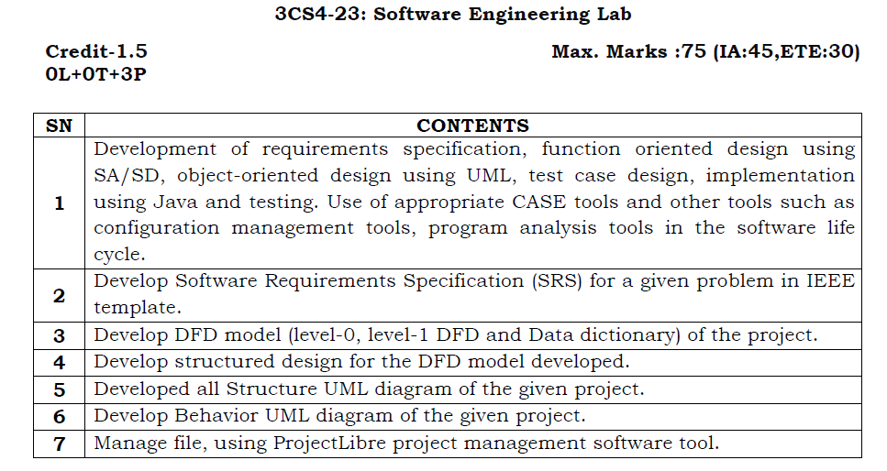
Scheme and Syllabus of SE Lab

Slide 4
Introduction to Software Engineering Lab
In this lab you will practice the software development life cycle (project management, requirements engineering, systems modeling, software design, prototyping, and testing) using CASE tools within a team work environment.
UML notation is covered in this lab as the modeling language for analysis and design.

Slide 5
Software Engineering Lab Objectives
Learn the software life cycle phases (project management, requirements engineering, software design, prototyping and testing).
Practice the software phases using a project.
Learn a number of CASE tools and use them in a project within a team work environment.
Get familiar with UML (modeling language for analysis and design).

Slide 6
Introduction to Software Engineering
Software Processes
IEEE defined a software process as: “a set of activities, practices and transformations that people use to develop and maintain software and the associated products, e.g., project plans, design documents, code, test cases and user manual”.

Slide 7
What is Software?
Software is combination of:
(1) instructions (computer programs) that when executed provide desired features, function, and performance;
(2) data structures that enable the programs to adequately manipulate information and
(3) documentation that describes the operation and use of the programs.

Slide 8
What is Engineering?
Engineering, is all about developing products, using well-defined, scientific principles and methods.
So, we can define software engineering as an engineering branch associated with the development of software product using well-defined scientific principles, methods and procedures.
The outcome of software engineering is an efficient and reliable software product.

Slide 9

LAYERS OF SOFTWARE ENGINEERING

Slide 10
Software Activities in A Process Model
A generic process framework for software engineering encompasses five activities:
Communication
Planning
Modeling
Construction
Deployment

Slide 11
Various Process Models
A number of software processes are available. However, no single software process works well for every project. Each process works best in certain environments.
Examples of the available software process models include:
Waterfall model (the Linear model)
Evolutionary development
Formal systems development
Reuse-based (component-based) development
Incremental model
Spiral model
Extreme Programming

Slide 12
Project Planning and Management
Project management is the process of planning and controlling the development of a system within a specified timeframe at a minimum cost with the right functionality.

Slide 13
Project Work Plan
Prepare a list of all tasks in the work breakdown structure, plus manage:
Duration of task.
Current task status.
Task dependencies.
Key milestone dates.

Slide 14
Tracking Progress
Gantt Chart:
Bar chart format.
Useful to monitor project status at any point in time.
PERT Chart:
Flowchart format.
Illustrate task dependencies and critical path.

Slide 15
Risk Management
Risk management is concerned with identifying risks and drawing up plans to minimize their effect on a project.
A risk is a probability that some adverse circumstance will occur.
Project risks which affect schedule or resources.
Product risks which affect the quality or performance of the software being developed.
Business risks which affect the organization developing the software.

Slide 16
Risk Management Process
Risk identification: identify project, product and business risks.
Risk analysis: assess the likelihood and consequences of these risks.
Risk planning: draw up plans to avoid or minimize the effects of the risk.
Risk monitoring: monitor the risks throughout the project.

Slide 17
Tools Used in the Lab
A complete software application requires from each of you a good level of knowledge of various tools. There are some tools which will be taught, but some are assumed you already know, if not, then learn those individually at other labs in syllabus or personally.
Some of tools are given as examples:
ProjectLibre and MS Project: for Project Planning / Management
Rational Rose and StarUML: for UML diagrams (Object Oriented Analysis and Design)

Slide 18
ProjectLibre
ProjectLibre is project management software, the leading alternative to Microsoft Project. This is desktop software, they are releasing a cloud version in the future.
Link: http://www.projectlibre.org
Features:
Microsoft Project replacement
Gantt Chart
Earned Value Costing
PERT Charts
Project Management software
RBS Chart
New version of OpenProj

Slide 19
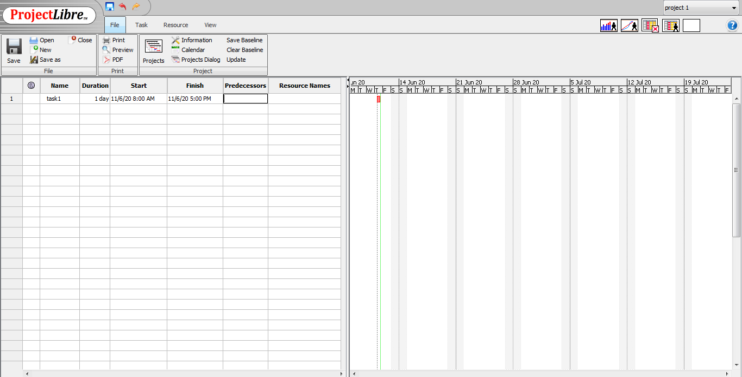
Screenshot of ProjectLibre Software running on Windows

Slide 20
StarUML
StarUML is an open source project to develop fast, flexible, extensible, featureful, and freely-available UML/MDA platform running on Win32 platform. The goal is a compelling replacement of commercial UML tools such as RationalRose and so on. Link: http://staruml.io/
It is a very useful tool for object oriented design and drawing UML diagrams.

Slide 21
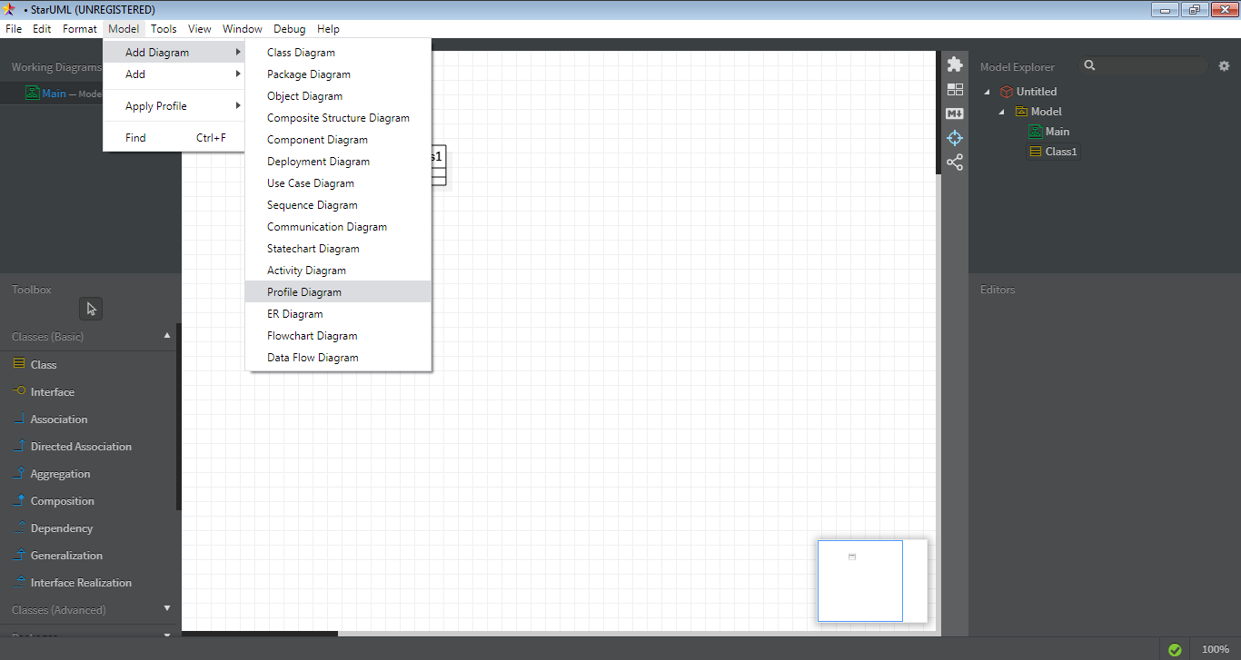
Screenshot of StarUML Software running on Windows

Slide 22
Instructions
Install StarUML & ProjectLibre and keep practicing on these software by exploring various menu and options available in software.
THANK YOU!

